Slide 1

Project Title: MTA Daily Ridership Analysis
Submitted by: Data Pioneers
Presenter's Name: Mohamed Alaa Mahmoud
Date: 5/9/2025

Slide 2
Project Idea
Problem: A decline in public transit ridership after the COVID-19 pandemic, affecting operations and planning.
Proposed Solution: Analyze daily ridership data using Power BI to uncover usage patterns and insights.
Unique Value: The project uniquely focuses on pre- vs. post-pandemic comparison and leverages professional tools to present data with actionable recommendations.

Slide 3
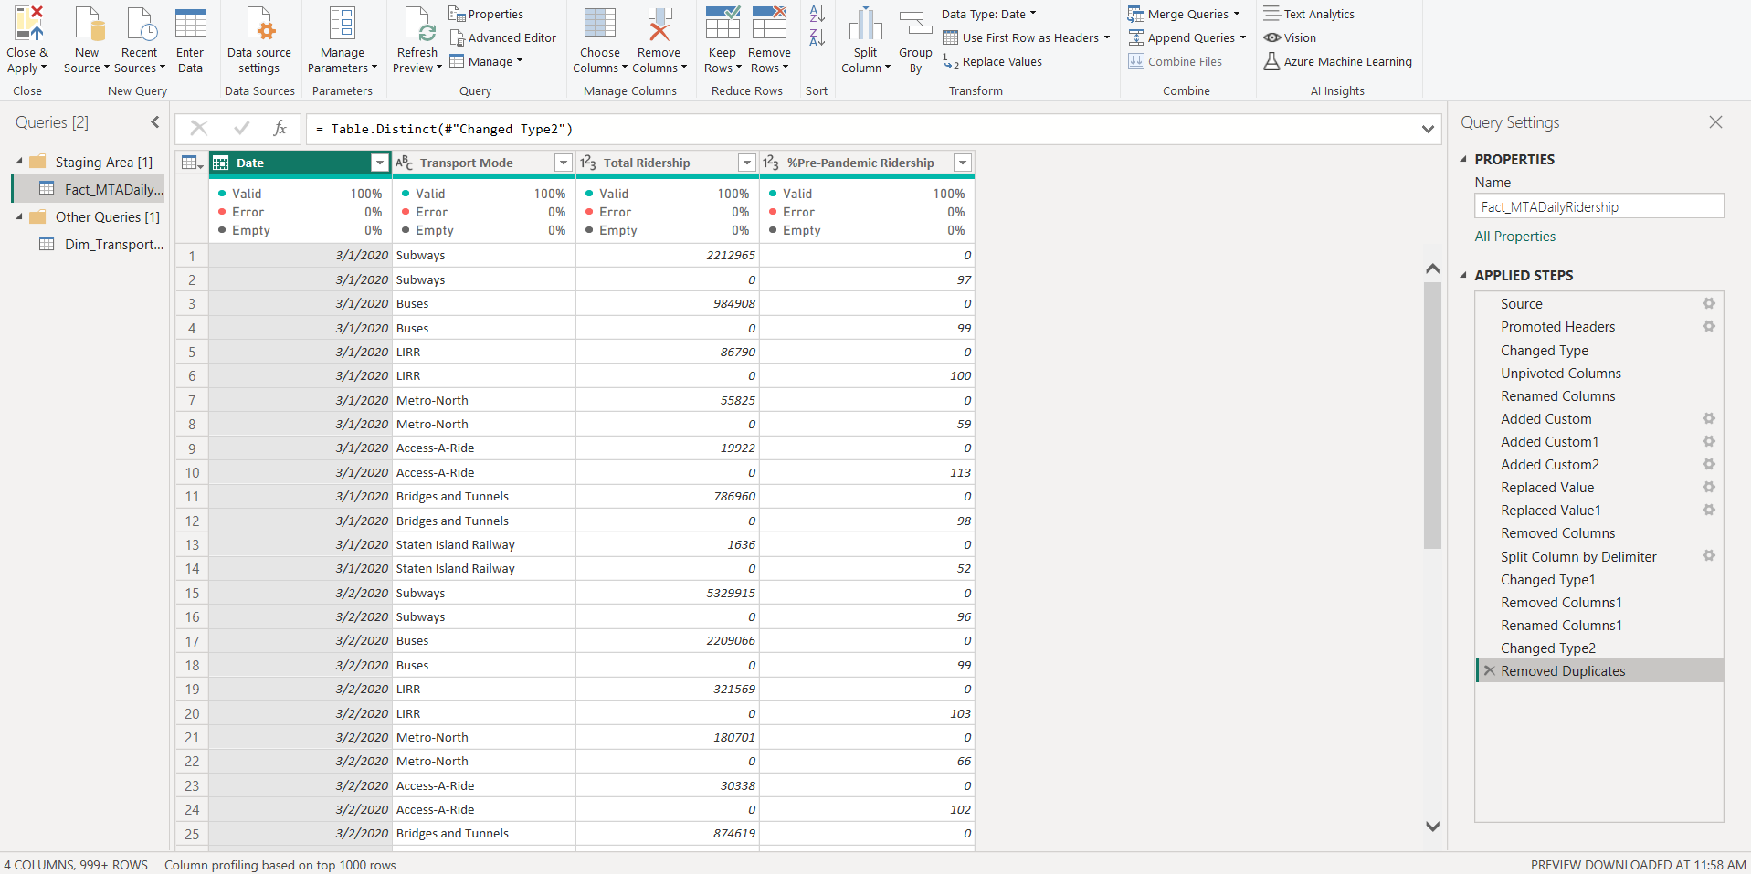
Project Wireframe
User Interfaces: A dashboard showing total ridership, recovery rates,
daily/seasonal distributions.
User Journey: Access the dashboard → Filter by date or transport mode → Extract insights → Support decision-making.

Slide 4
End Users + Features
End Users: Transit authorities, data analysts, decision-makers.
Key Features: Weekday/weekend analysis, seasonal trends,
pre vs post pandemic comparison, busiest days.
How It Helps: Improves service planning, identifies peak periods, and supports strategic decisions.

Slide 5
Data Structure
Source: Excel file with:
14 Measure Columns (e.g., total ridership, recovery %)
2 Dimension Columns (date, transport mode)
Star Schema Model in Power BI:
Dim Calendar,
Dim Transport Mode
Fact MTA Daily Ridership
Cleaning Steps: Unpivot data, remove duplicates, build dimension/fact tables via Power Query.
Data Dictionary: Kay Columns Explanation

Slide 6
Programming Languages + Frameworks
Power BI: For analysis and visualization.
Power Query: For data cleaning and transformation.
DAX: For custom calculations and KPIs.
Data Dictionary: Key Columns Explanation
Excel: Original data source.
Power BI Service: For sharing the dashboard.

Slide 7
Live Application + Test
Current State: Dashboard is published via Power BI Service (demo version).
Testing: Validated filters, slicers, and KPIs.
Feedback: Positive — intuitive and informative dashboards that highlight clear insights.

Slide 8
Deliverables
Final Project . pbix
Final Project Report )PDF)
Data Model
Timeline:
Week 1: Data Cleaning
Week 2–3: DAX – Visualization – Data Dictionary
Week 4: Finalizing and Reporting

Slide 9
Project Team + Roles
Team Leader: Mohamed Alaa Mahmoud
Team Members:
Mohamed Alaa – Design Power BI dashboard
Haneen Elsayed – Data Cleaning
Ahmed Emadeldin – Visualization
Ganna El-Tabakh – Analysis
Karim Ibrahim – QA & Testing
Hady Khaled – Documentation
Collaboration Tools: Microsoft Teams, Zoom Meating,

Slide 10
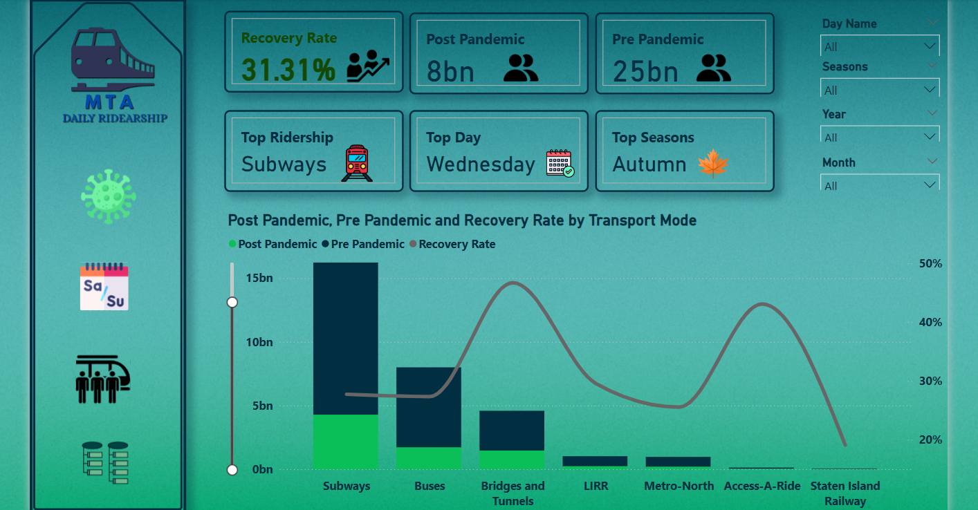
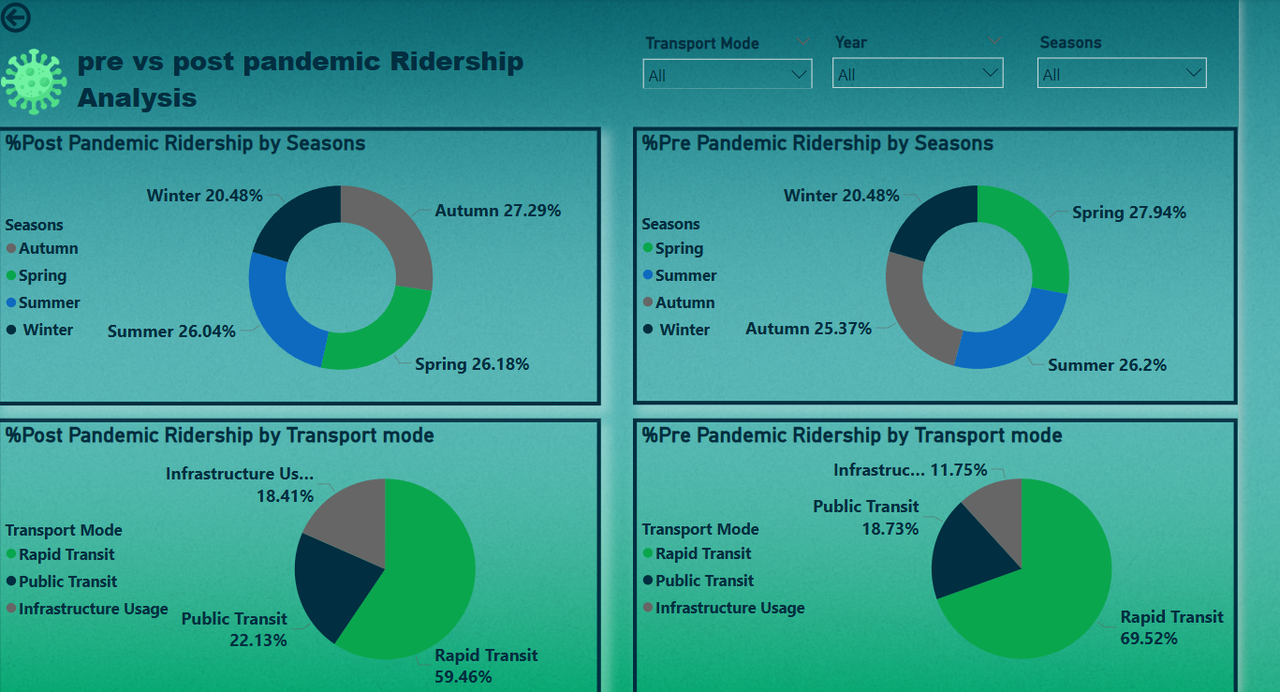
Dashboard Snapshots

Slide 11
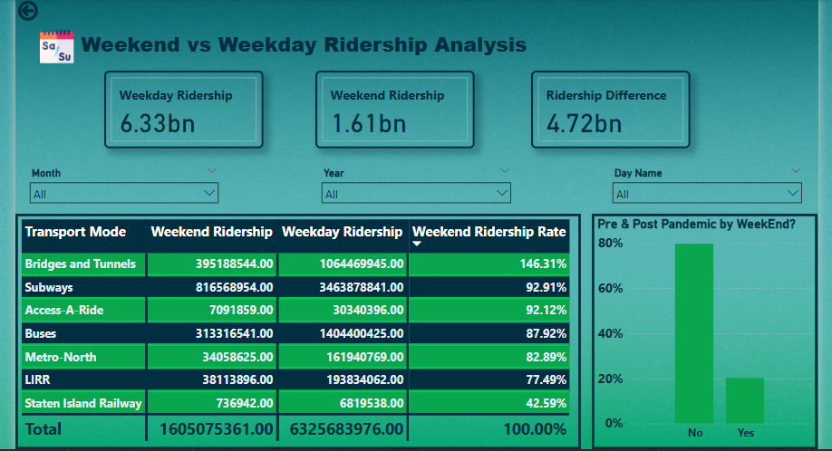
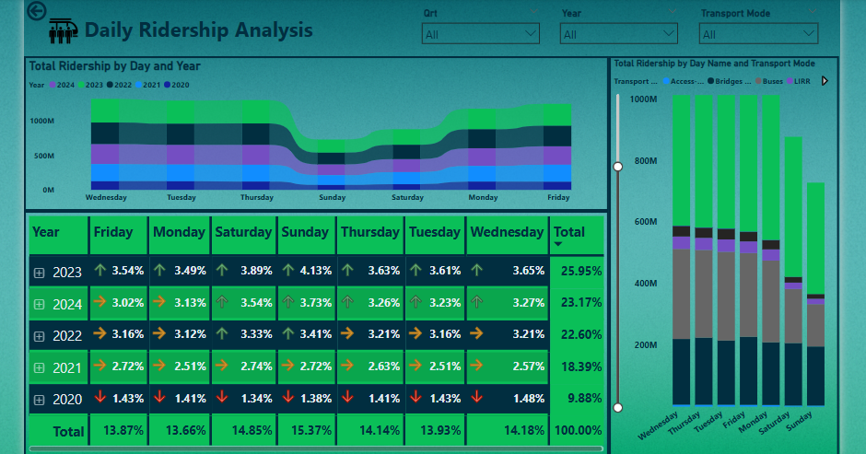

Slide 12
Thank you
Thank you for your attention and time. We truly appreciate the opportunity to present our project. We look forward to your questions, feedback, and suggestions!

